Slide 1



STAT303: Time Series Analysis
Professor Dr. Sithu Aung
Report: Electricity Demand Forecasting with Hybrid Statistical and ML Algorithms
Authors: Tatiana Gonzalez Grandon, Johannes Schwenzer, Thomas Steens, Julia Breuing
Data is the new oil. Insight is the new currency. Models become new electricity.

Slide 2







STAT303: Time Series Analysis
PAPER OVERVIEW
Predict national electricity demand (hourly, long-term) for Ukraine
Improved Decision-Making
Grounded in evidence, not guesswork
Cost Reduction
Reduce the unnecessary costs
Performance Optimization
Monitor and improve the electricity load continuously

Slide 3
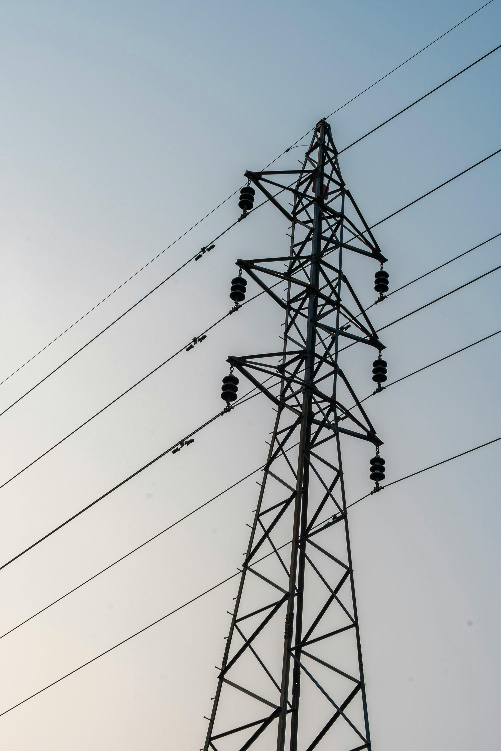

STAT303: Time Series Analysis
Home
About
Conclusion
Introduction
Electricity drives economic growth and development, today.
Key role in low - carbon transition
Forecast accuracy → major cost savings (e.g., 1% = millions saved)
Limitations
Forecasting demand is still difficult.
The system is complex, influenced by many factors
Requires predictions across different time horizons (from daily operations to long-term planning)

Slide 4



STAT303: Time Series Analysis
Home
About
Context
Types of Forecasting
To handle this, forecasting is divided into three levels:
Short-term
For daily operations
Medium-term
For planning and maintenance
Long-term
For infrastructure and investment

Slide 5





STAT303: Time Series Analysis
Home
About
Context
Literature on electricity load forecasting
Two Main Approaches
Literature Review
Classical Statistical Techniques (CST)
Regression, ARIMA (Linear model)
Machine Learning (ML)
ANN, RNN, LSTM (Non-linearity)
Hybrid Models (Key Idea)
Combine CST + ML
Performance Insights (Past papers)
CST: MAPE ~2.6%–3.9%
ML: MAPE ~3.6%–3.7%
Mixed results → no clear winner
This Paper will contribute:
Limitations/Gap in Literature
Hybrid CST + LSTM model
Predict long-term demand with hourly detail
Case study: Ukraine (2013–2020)
ML mostly used for short-term forecasting
Long-term forecasting still underdeveloped
Models often tested separately

Slide 6

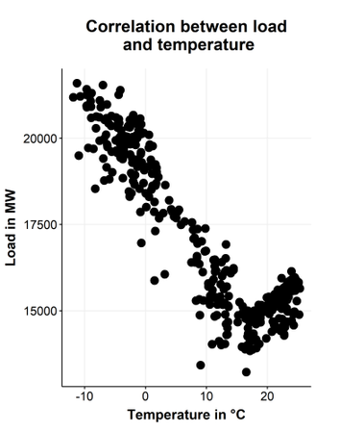
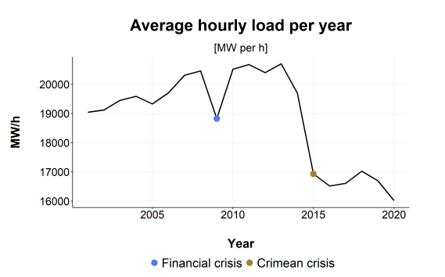
STAT303: Time Series Analysis
Home
About
Context
Overview of Ukraine’s Electricity Demand
04
Temperature Effect
Strong influence on demand
Nonlinear relationship (not straight line)
“Hockey stick” pattern:
Very high demand in cold weather
Moderate increase in hot weather
01
Ukraine’s Context
Developing country in political & economic crisis
Energy security is critical
02
Long-Term Trends
Demand affected by macroeconomic factors:
Population, GDP, GDP growth
Major drops:
2009 financial crisis
2014 Crimean crisis
03
Seasonal Patterns
Winter → highest electricity demand
Daily (hourly) peaks exist
Mid-term + short-term patterns visible
Electricity demand is strongly influenced by temperature in a nonlinear “hockey-stick” pattern, with much higher usage in cold weather, since heating (5.3%) has a greater impact than cooling (1.9%).

Slide 7
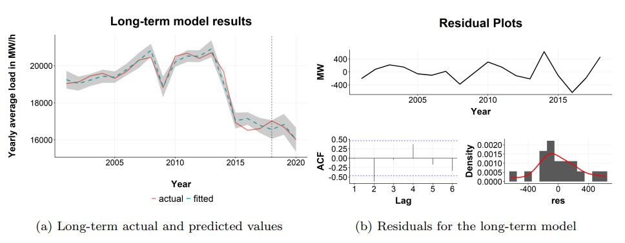
STAT303: Time Series Analysis
Home
Models
Results
Model Structure
Macroeconomic factors strongly explain long-term electricity demand. Model is statistically valid and stable
Electricity demand is split into 3 components:
Long-term (yearly trend)
Medium-term (daily/seasonal)
Short-term (hourly variation)
Additive model: combines all components
Long-Term Model
Predict yearly average demand
Based on macroeconomic factors
GDP deflator
Industrial value added
GDP growth rate
Service sector contribution
Uses multiple linear regression
D̄L(y) = βL,1 + βL,2 * GDPδ(y) + βL,3 * IND(y) + βL,4 * GRO(y) + βL,5 * SERV(y) + w(y)
Model Selection Process
Model Validation
Tested 2¹⁸ regression models
Ranked using AICc
5-fold cross-validation
Filtered using RMSE and MAE
Residuals tested for normality (Shapiro-Wilk)
p-value = 0.62 → good fit
Variance of noise estimated

Slide 8
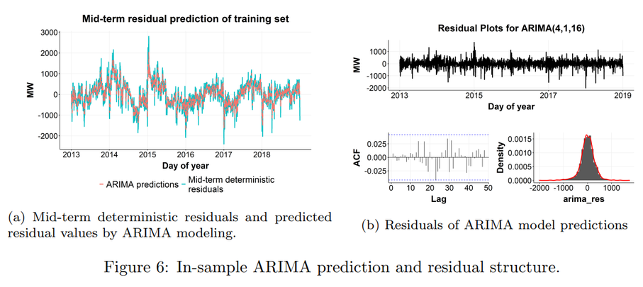
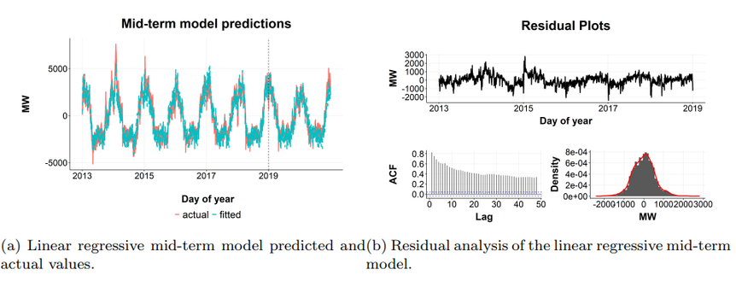
STAT303: Time Series Analysis
Home
Models
Results
Mid-Term Model
Two approaches are used for residuals:
First, modeled using a linear regression (LM) with
Temperature,
Seasonality,
Holidays, and
Lag effects
Remaining errors (residuals) still contain structure → Modeled separately
ARIMA(30,1,25) → captures linear autocorrelation patterns
LSTM (Seq2Seq + attention) → captures nonlinear and long-term dependencies
Final step combines both into a hybrid model

Slide 9

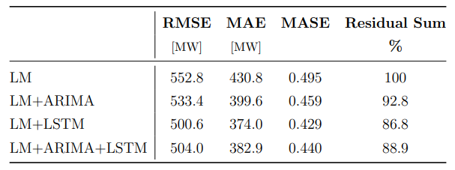

STAT303: Time Series Analysis
Home
Models
Results
Hybrid Model Results
LSTM-based hybrid model gives the best forecasting accuracy
We first model the main trend using regression, then improve accuracy by modeling residuals using ARIMA and LSTM
Tested combinations:
LM
LM + ARIMA
LM + LSTM ✅
LM + ARIMA + LSTM

Slide 10







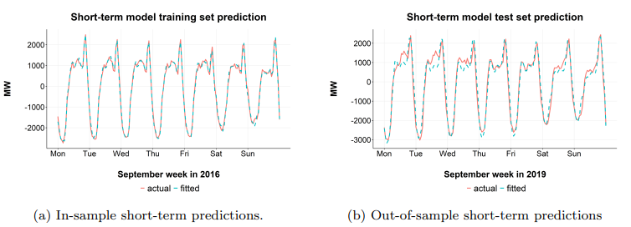

STAT303: Time Series Analysis
Home
Models
Results
Short-Term Model
Hourly Patterns
Model Structure
Focus: hourly demand variation within a day
Remove long + medium effects → isolate daily pattern
Linear regression:
Hour-of-day (ToH) dummy variables
Separate models for each month & weekday
Residual modeling:
ARMA models (stationary data)
Captures short-term dependencies
Works well due to strong daily cycles
Model Analytics
Hourly demand is highly repetitive
Simple models (Regression + ARMA) are enough
No need for complex ML like LSTM

Slide 11
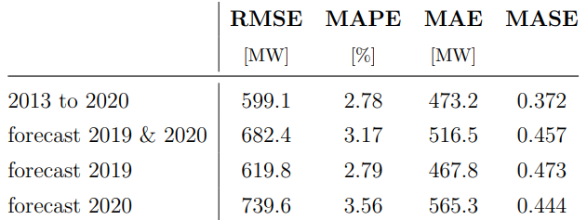

STAT303: Time Series Analysis
Home
Models
Results
Finalized Model
Combine all models
Long-term (yearly trend)
Medium-term (daily + seasonal)
Short-term (hourly pattern)
Checks if the model works on unseen data
Results
Test on real data
Train model: 2013–2018
Test model: 2019 & 2020
MAPE ≈ 3.17% (very accurate)
2019: 2.79%
2020: 3.56%

Slide 12




Home
About
Conclusion
Conclusion
This paper proposes a hybrid model for national electricity demand forecasting that combines classical statistical methods with machine learning.
The model splits demand into
a.
Long-term is modeled using regression on macroeconomic factors
b.
Medium-term uses regression + ARIMA + LSTM
The model performs well (~3% error), but it depends on future macroeconomic and weather data. The hybrid model balances interpretability and accuracy, providing reliable long-term electricity forecasts while capturing complex real-world patterns.
c.
Short-term uses regression + ARMA

Slide 13






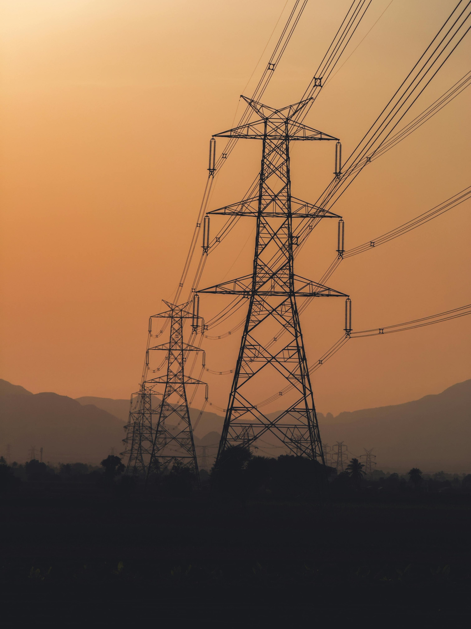
STAT303: Time Series Analysis
Home
About
Conclusion
Limitation:
Requires future macroeconomic data
Depends on weather projections
Future Work
Apply to other countries (Myanmar)
Fully automated forecasting system

Slide 14
STAT303: Time Series Analysis
Home
About
Conclusion
Thank You
For Your Attention
Special Thanks to Prof. Sithu Aung for your guidance and support throughout the course
Data is not about numbers, it's about understanding

Slide 15
STAT303: Time Series Analysis
References
Grandon, T. G., Schwenzer, J., Steens, T., & Breuing, J. (2023, April 11). Electricity Demand Forecasting with Hybrid Statistical and Machine Learning Algorithms: Case Study of Ukraine. arXiv.org. https://arxiv.org/abs/2304.05174
Huang, C., & Petukhina, A. (2022). Applied Time Series Analysis and Forecasting with Python. In Statisctics and computing/Statistics and computing. https://doi.org/10.1007/978-3-031-13584-2

